Slide 1

KGiSL INSTITUTE OF TECHNOLOGY
COIMBATORE
DEPARTMENT OF computer science & engineering
MINI Project phase review#03
CRUOR COLLECTION SYSTEM
TEAM MEMBERS:
711719104063 Pooja B
711719104083 Sasi Keerthana R
711719104084 Sasi Kumar P
711719104101 Tharini M
Under the guidance of :
Ms Ramya S R AP/CSE
MINI PROJECT-THIRD REVIEW
Department of CSE, KGiSL Institute of Technology, Coimbatore
01-06-2022

Slide 2

Agenda
Objective of the project work
Existing System
Proposed System
Expected Outcome
References
Timeline

Slide 3
Abstract
To develop a web based system for blood banks to manage information about the donors and blood stock.The hospital can send message alert to all the people who are all near to the hospital. The hospital can check availability of required blood from volunteers and send the message alert to all the donors.

Slide 4
EXISTING SYSTEM
There is no proper software to keep any record in blood bank and it is difficult to track the records of donor.
Manually to keep accounts is tedious and risky job to maintain those account for long period is difficult.
DRAWBACKS
Improper management of blood leads to wastage of the available blood bank.
Time consuming is high to store and update the data.

Slide 5
LITERATURE SURVEY
TITLE | PUBLICATION YEAR | AUTHOR / PUBLISHER | DESCRIPTION
Modelling and simulation of blood collection | 2021 | Edgar Alfonso | Mobile blood collection
The optimization of blood donor information and management system | 2020 | Shabana S | Blood transfusion process
Blood donor classification data mining models | 2020 | Santhanam T | Development of donor classification
Supply chain management for blood and blood product | 2019 | Jeroen Benien | Demand for blood products
Rasberry-Pi based Embedded blood donation | 2019 | Sunil P | Android application of student blood donor

Slide 6
PROPOSED SYSTEM
The donor can get text message in time and save his relative or friends life.
It helps the hospital who are in need of a blood by giving them all details of blood group availability.
ADVANTAGES
It saves a time as they can search donors online without going anywhere and work is reduced very much which prevails in the present system.

Slide 7
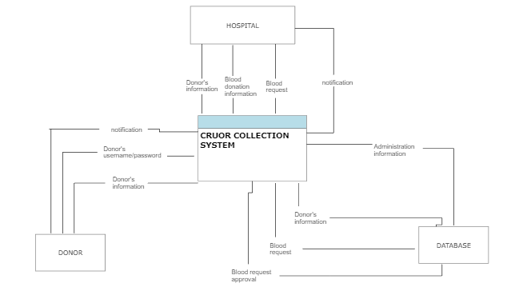
ARCHITECTURAL DIAGRAM

Slide 8
Modules split up
Module 1:Design a home page
Module 2:Collect donor’s information
Module 3:Blood request message alert
Module 4:Blood received message alert

Slide 9
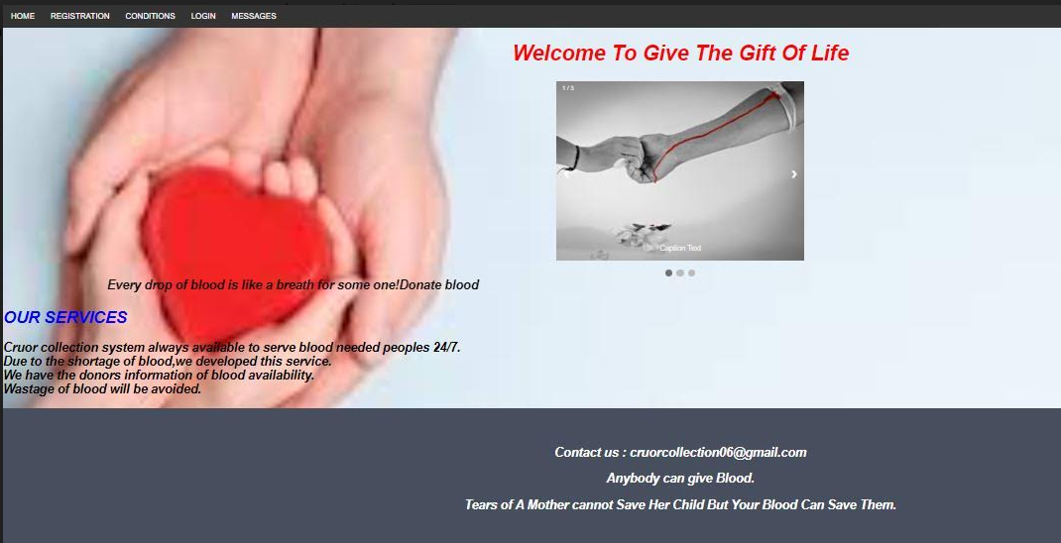
module 1- SCREENSHOTS

Slide 10
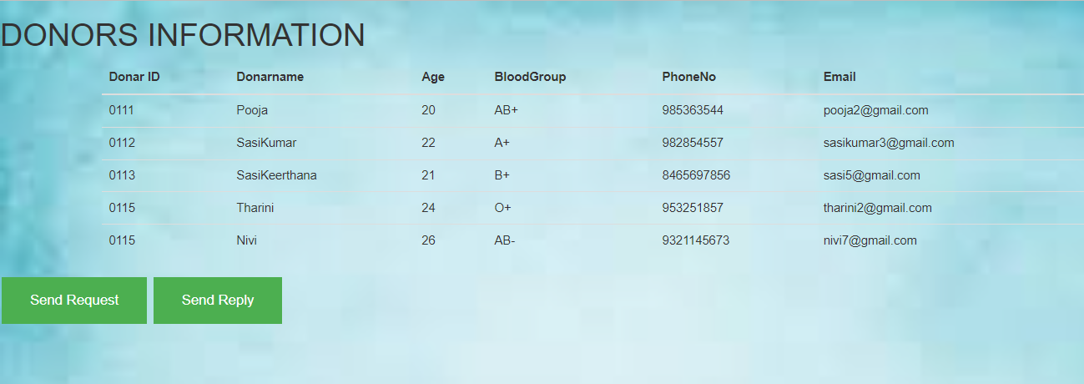
Module 2 - SCREENSHOTS

Slide 11
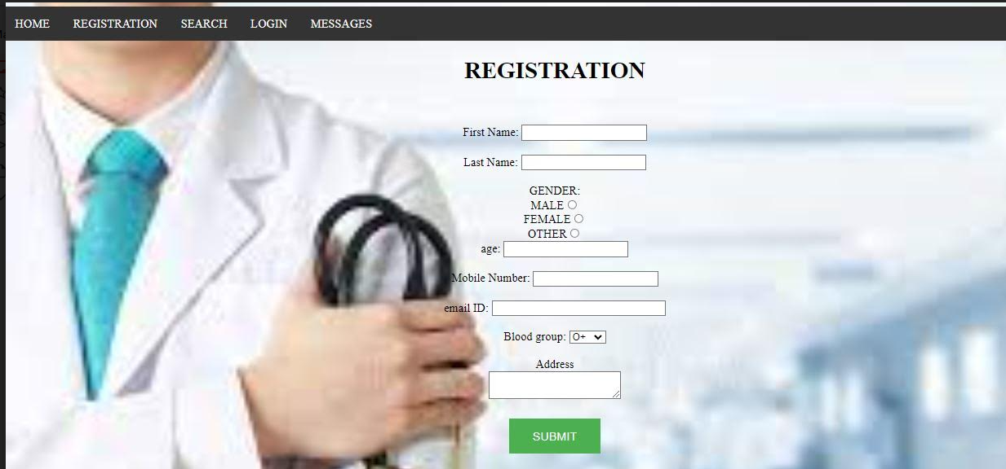
Module 2 - SCREENSHOTS

Slide 12
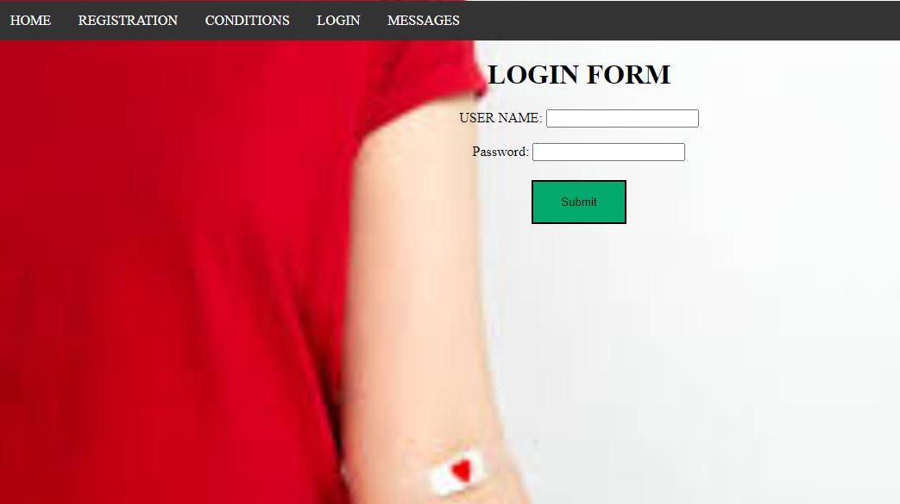
Module 2 - SCREENSHOTS

Slide 13
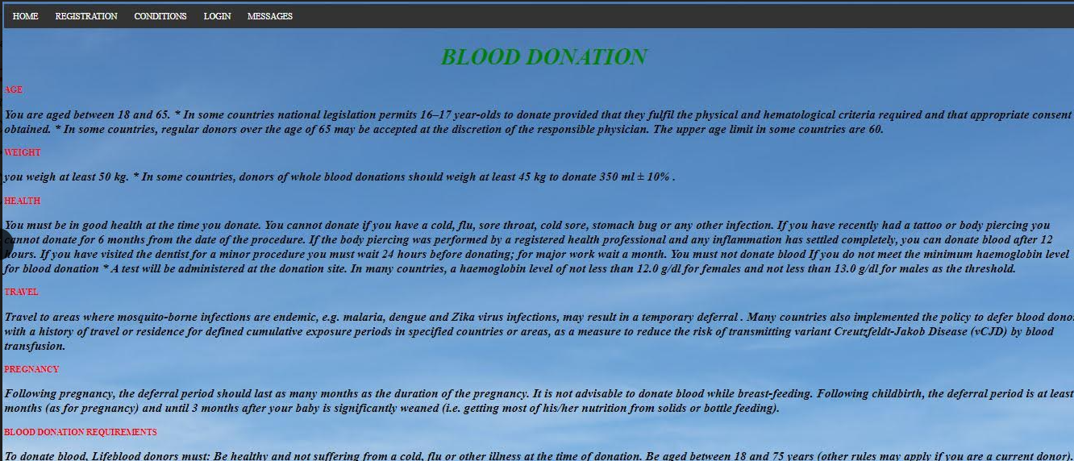
MODULE 2 - SCREENSHOTS

Slide 14
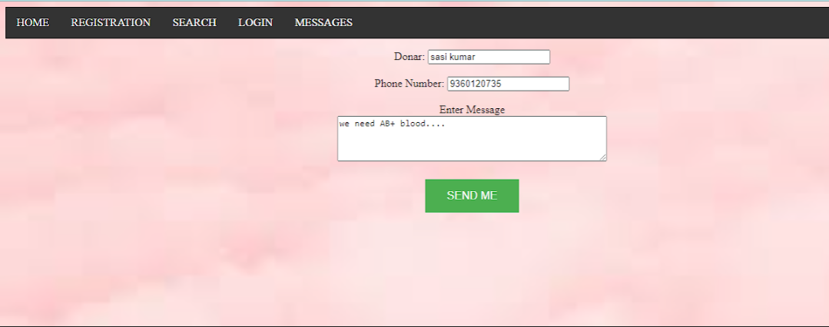
MODULE 3 - SCREENSHOTS

Slide 15
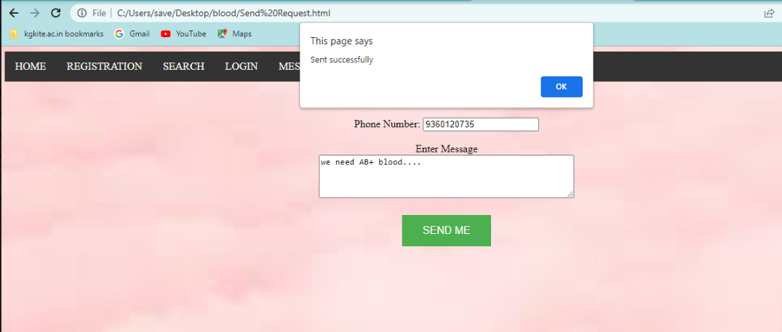
MODULE 4 - SCREENSHOTS

Slide 16
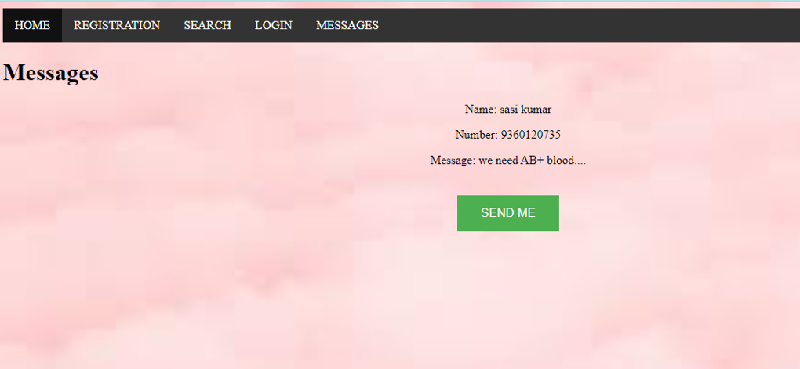
MODULE 4 - SCREENSHOTS

Slide 17
EXPECTED OUTCOME
To maintain records of blood donors information in the database system.
The hospital can send a text message to the donor when the blood is needed.
After receiving the blood,remaining donors will get the message as “BLOOD RECEIVED”.

Slide 18
REFERENCEs
[1] Michael Chau, Eddie Cheng and Chi Wai Chan, Data Analysis for Healthcare: A Case Study in Blood Donation Center Analysis. Proceedings of Sixteenth Americas Conference on Information Systems (AMICS), 2019.
[2] Shyam Sundaram and T Santhanam, Classification of Blood Donors using Data Mining. Proceedings of the Semantic E-Business and Enterprise Computing, pp, 2019.
[3] Li B. N., & Dong, M. C. Banking on blood, Computing and Control Engineering (August–September), 22–25, 2020.
[4] Glynn S A, Kleinman S H, Schreiber G B, Zuck T, McCombs S, Bethel J, Motivations to donate blood: demographic comparisons, Transfusion, 2021.

Slide 19
REFERENCEs
[5] Pawar R, Thigale P, Walekar G, Thakar and D. Joshi, 2019-Optimal Facility for Location Tracking of Blood Bank and Donor. International Research Journal of Engineering and Technology 2020.
[6] Parikh S, P. Kathiria, Y. Vaghela, H. Shah and D. Dholakiya, 2018.A Geo-Location based Mobile Service that Dynamically Locates and Notifies the nearest Blood Donors for Blood Donation during Medical Emergencies. International Journal of Computer Applications 2018.
[7] Guide to the preparation, use and quality assurance of blood components, 16th edition. Strasbourg: Council of Europe 2019.

Slide 20
REFERENCES
[8] Boulton F. Evidence-based criteria for the care and selection of blood donors, with some comments on the relationship to blood supply, and emphasis on the management of donation-induced iron depletion. Transfusion Medicine 2021.
[9] Newman B. Iron depletion by whole-blood donation harms menstruating females: the current whole-blood-collection paradigm needs to be changed. Transfusion 2018.
[10] Hillyer C Comparable safety of blood donation in high-risk autologous donors versus non-high-risk donors and directed donors in a hospital setting. American Journal of Clinical Pathology 2020

Slide 21
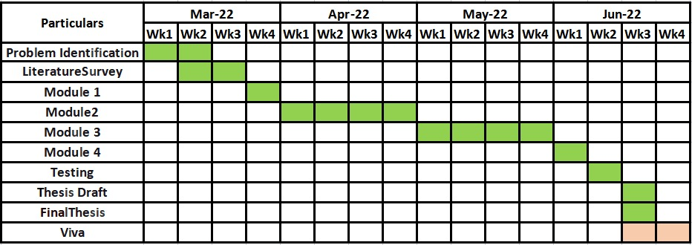
TIMELINE

Slide 22
THANK YOU

